Slide 1

Friends network analysis
IDS 564 – SOCIAL MEDIA AND NETWORK ANALYSIS
PRESENTED BY:
ROBIN BEURA : 658657743
SUNAINA TARIMALA : 664375627

Slide 2

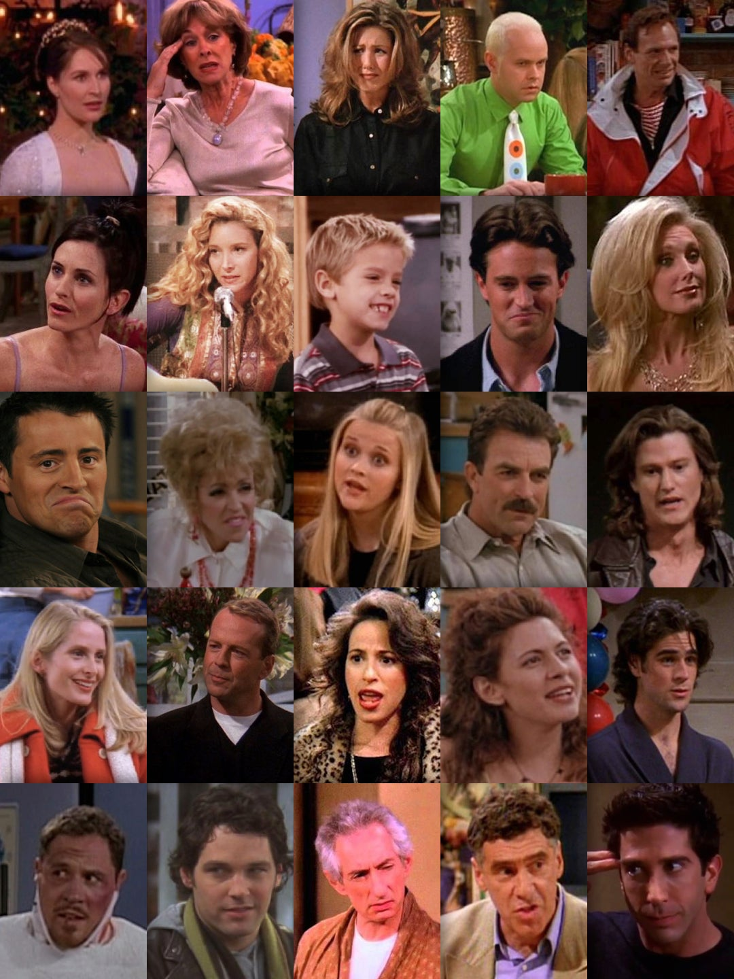
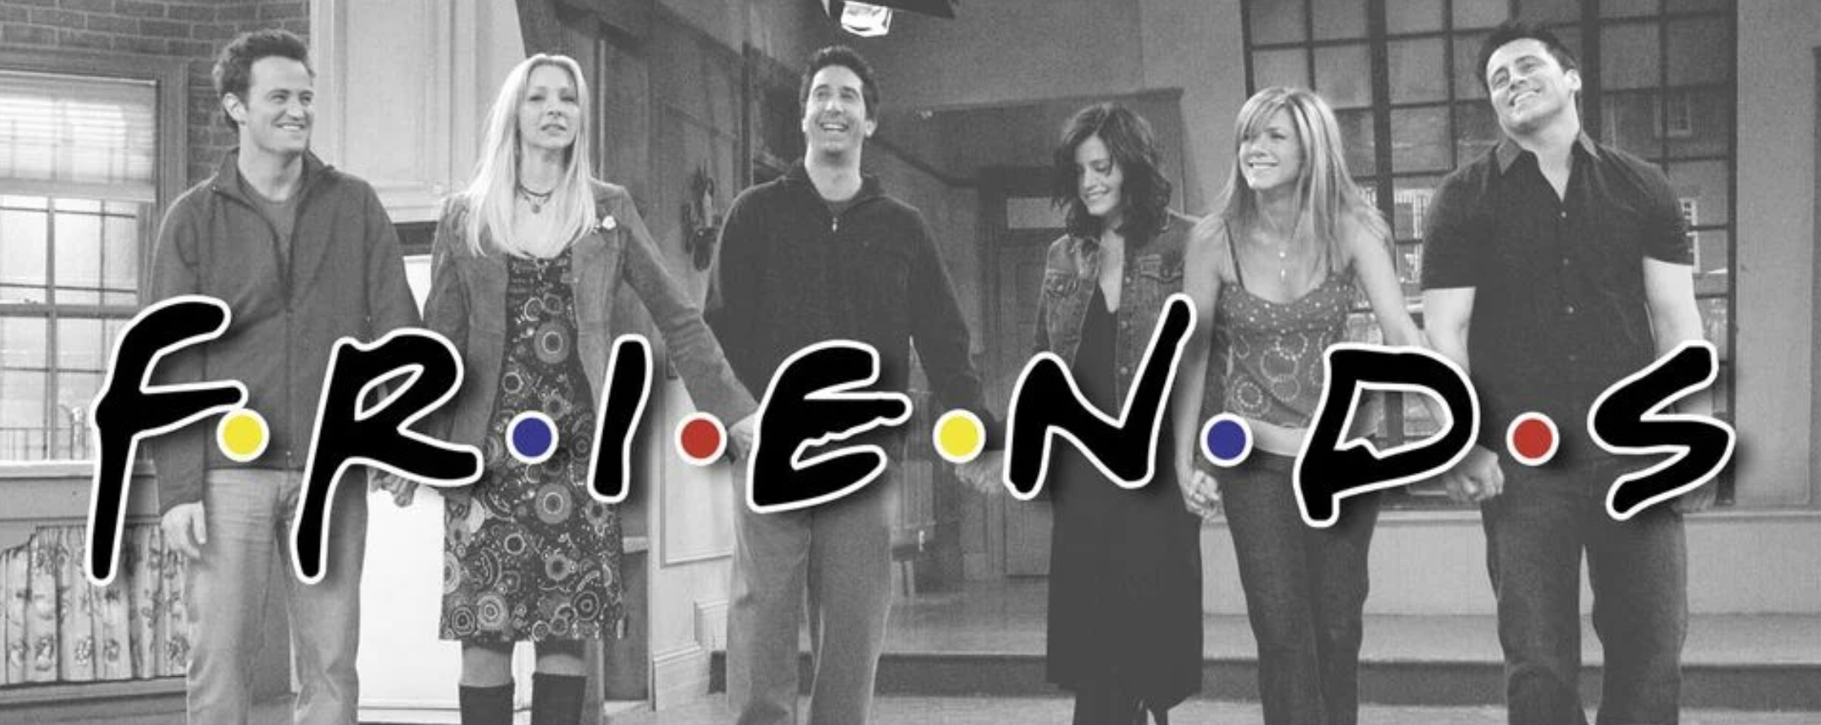

BACKGROUND
Friends is a popular American sitcom, which aired from September 22, 1994, to May 6, 2004, lasting ten seasons.
The sitcom revolves mainly around 6 friends – Rachel Green, Phoebe Buffay, Monica Geller, Ross Geller, Joey Tribbiani and Chandler Bing.
Given that we are huge fans of this show, we wanted to see how these major 6 characters along with the other minor characters form distinct communities, and if we could identify the most important characters for each of these communities.
In doing this, we ignore the connections formed between the 6 major characters.

Slide 3

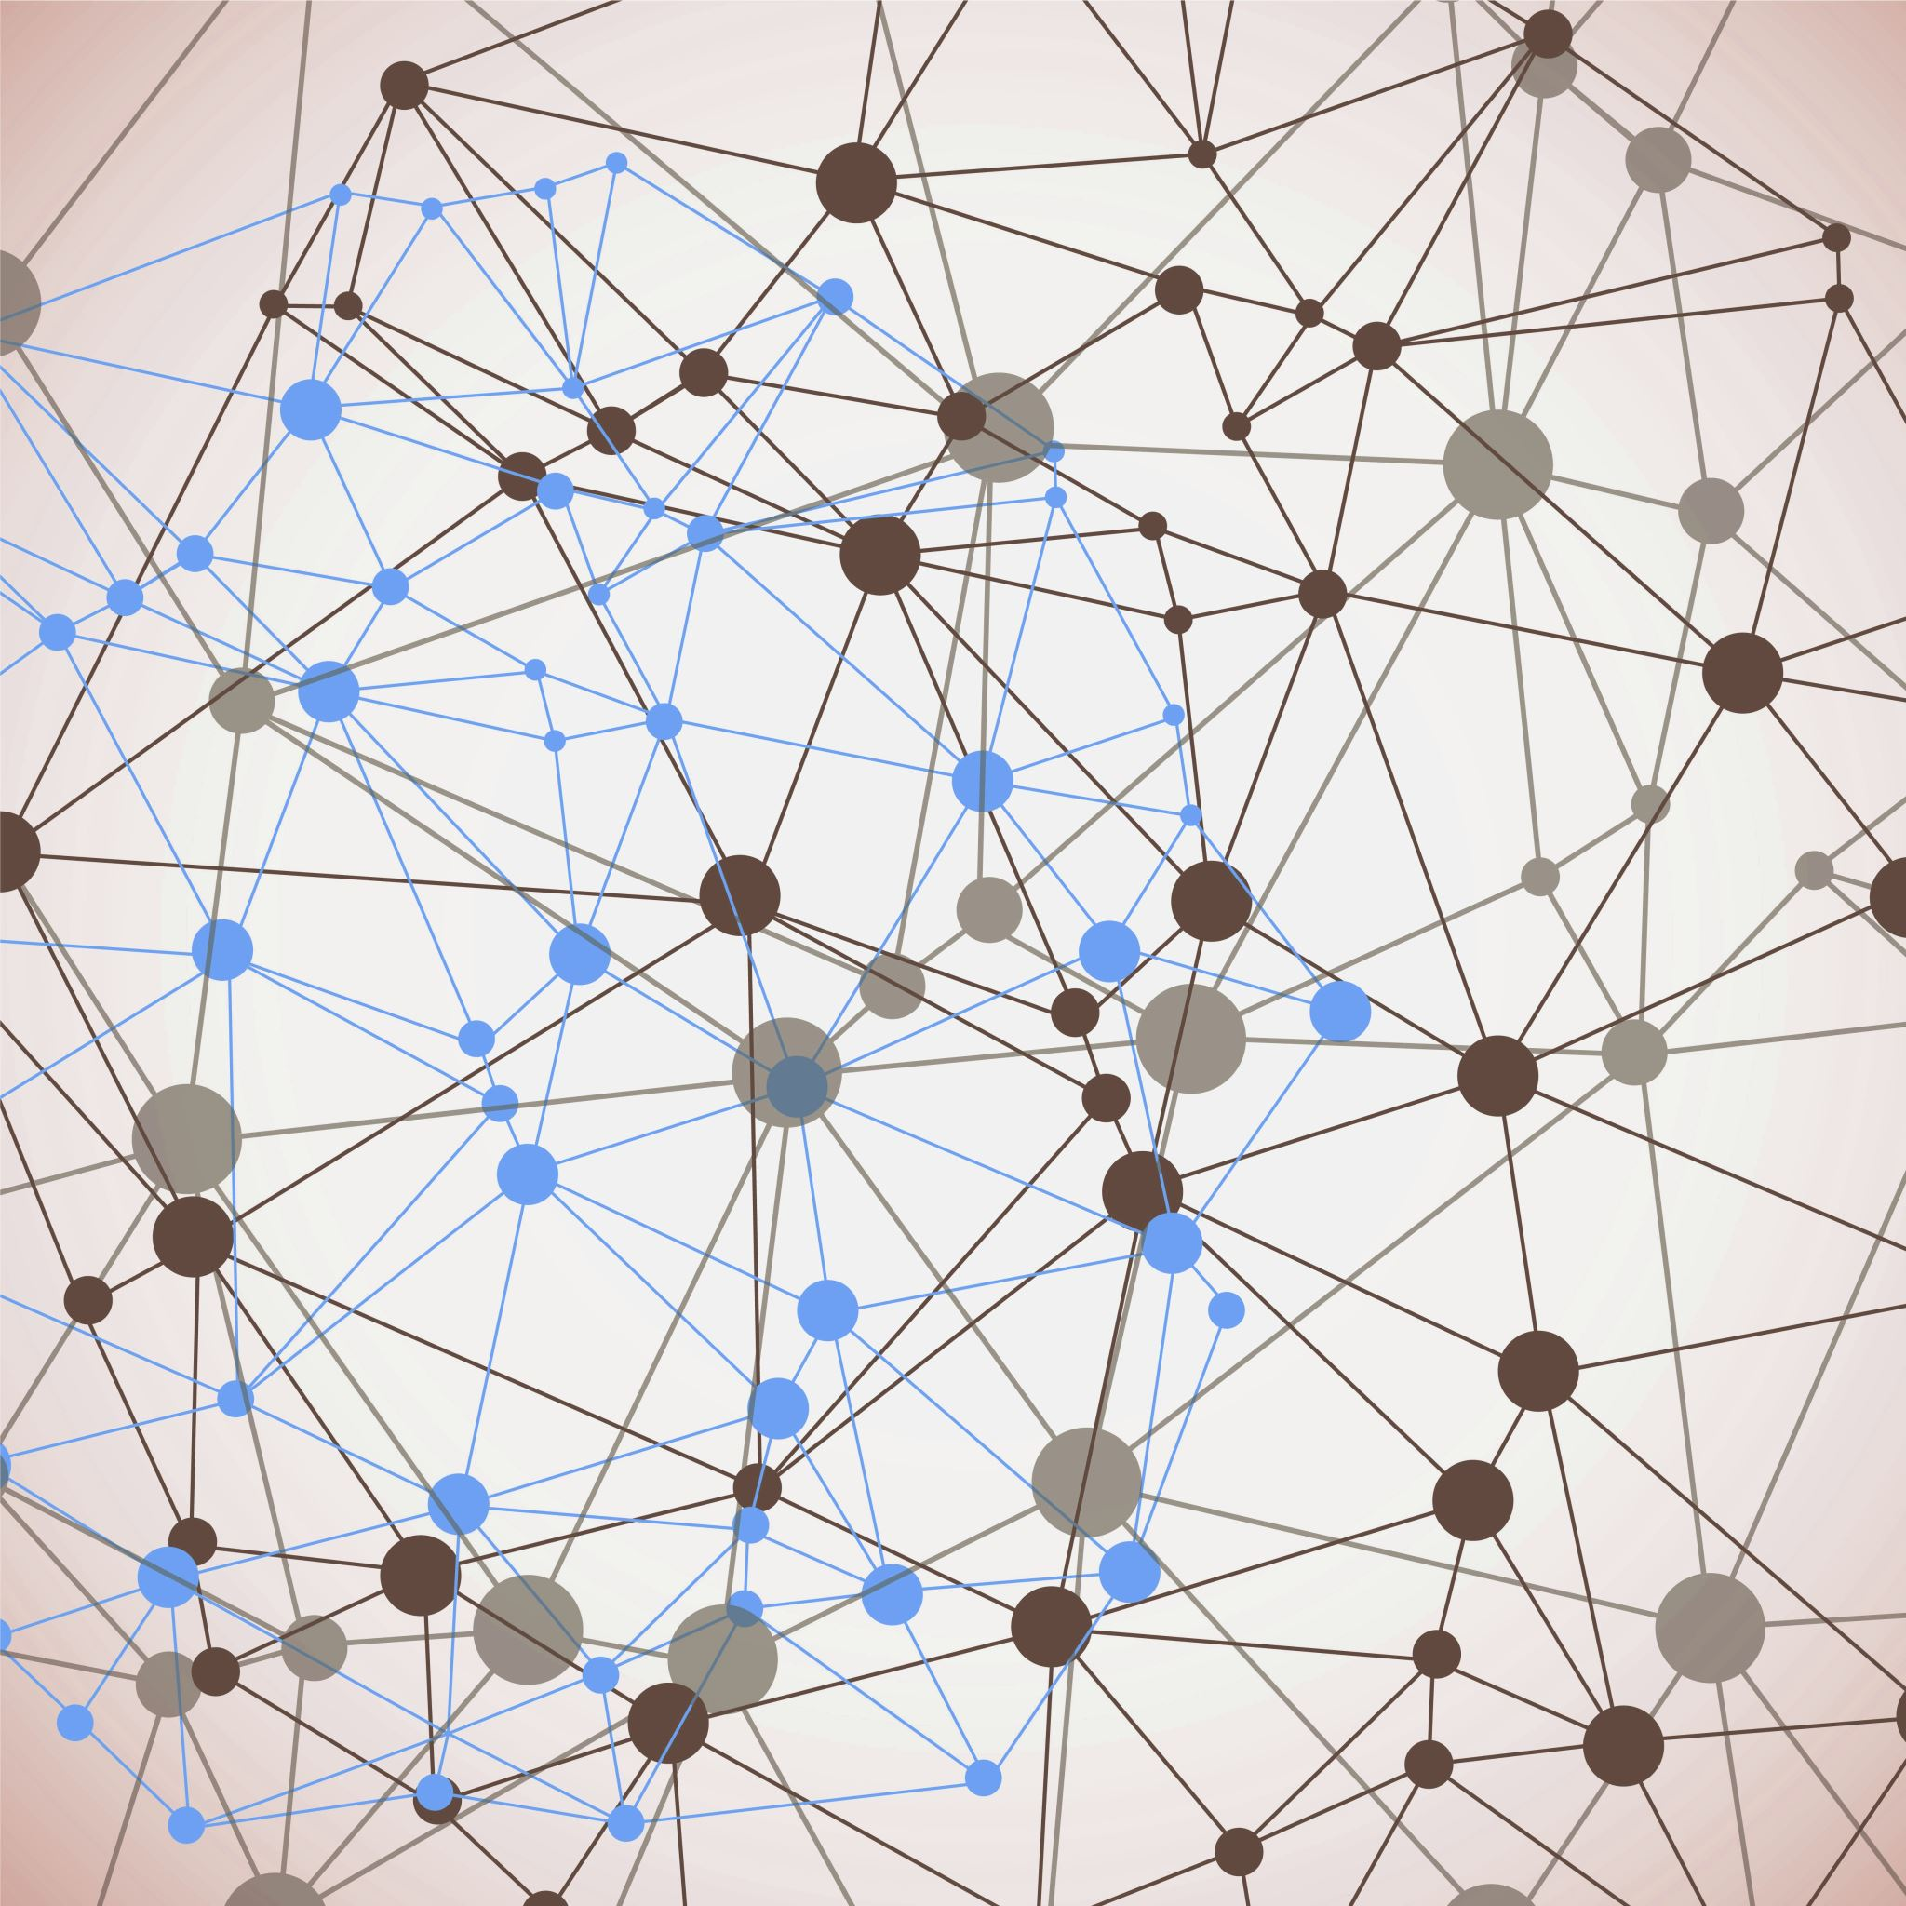
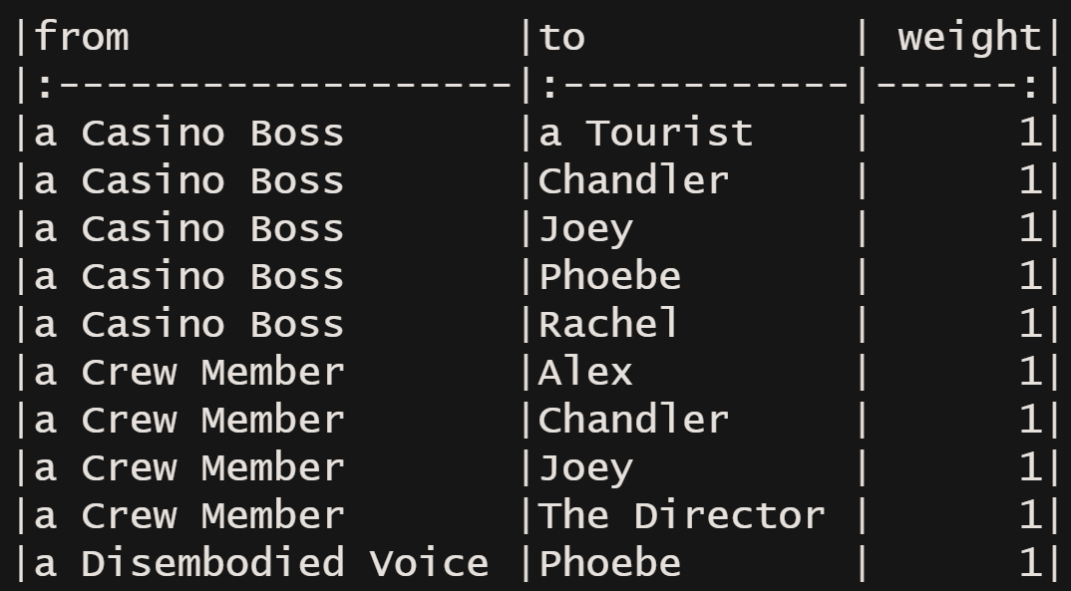

OVERVIEW
There are a lot of interactions that happen, and we wanted to check if the network can answer some of the facts that we already know.
The purpose of this analysis is to find out how the characters of this sitcom form a network and identifying the characters who influence the network.
The scraped data has table of numbered scenes for each episode and the names of the characters in those scenes

Slide 4

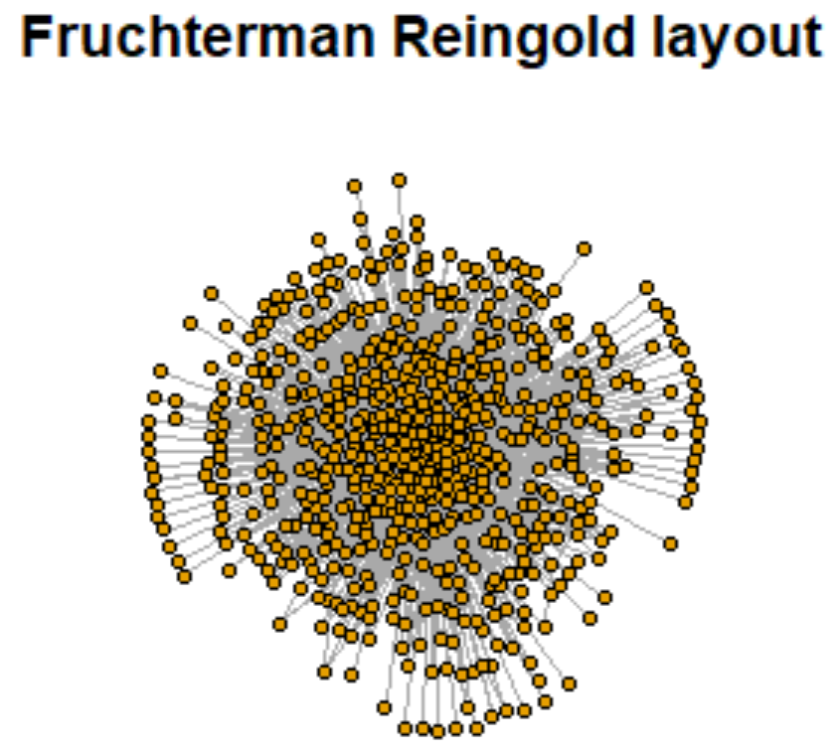
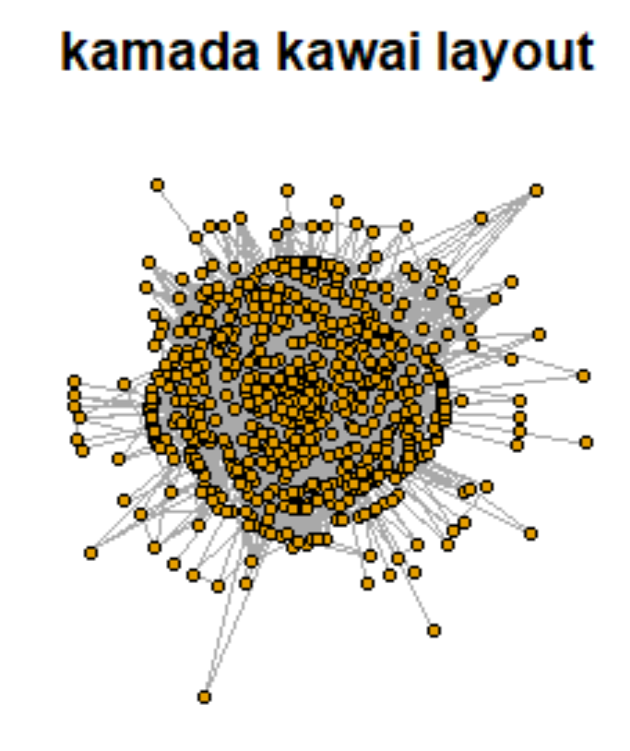
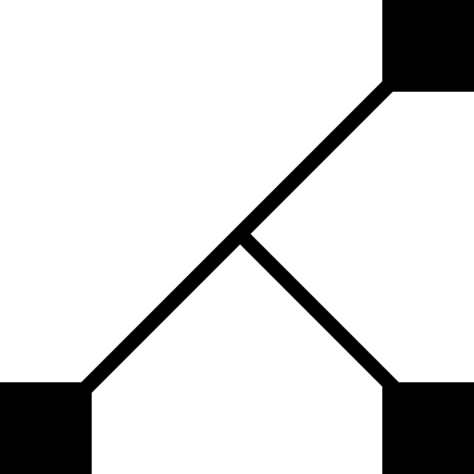
DATASET DESCRIPTION AND NETWORK LAYOUT
Data Source
Acquisition – Keith McNulty scraping-structured-data-from-semi-structured-documents
Author of Handbook of Regression Modeling in People Analytics
Network Statistics
Nodes: 650
Edges: 2961
Attributes: from, to, weight(i.e., interaction)
The main 6 characters in the network would form strong communities so we removed the edges between the characters to show they don't know each other.

Slide 5

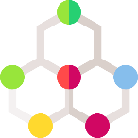

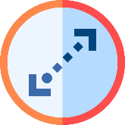

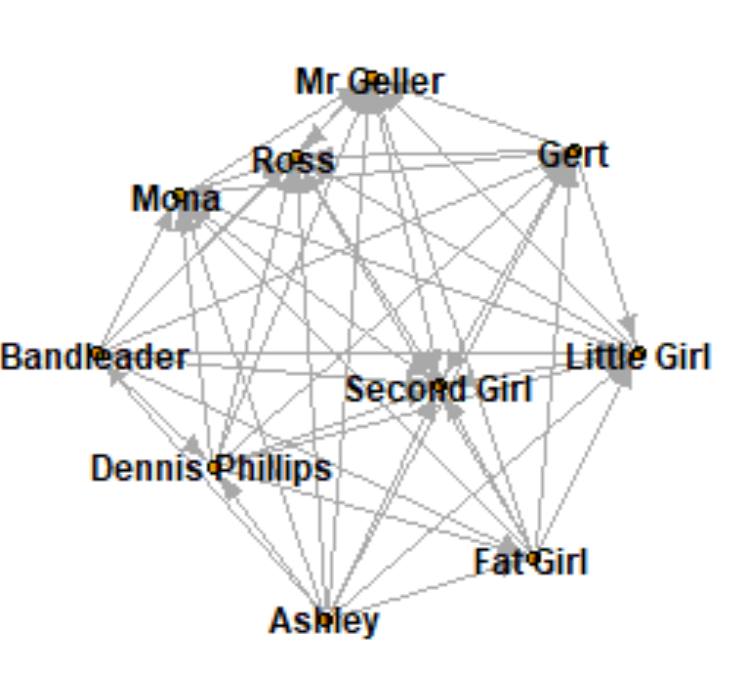


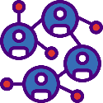

NETWORK MEASURES AND STATISTICS
Connectivity
Clique Structures
All components of the graph are strongly connected.
There 413 cliques of size 2, 525 cliques of size 3 on smaller size.
There are 6 cliques of size 10 which are the biggest cliques. These suggests that these are a cohesive group of people that are tightly connected to each other.
Diameter
The diameter is the greatest distance between any pair of nodes/users.
Diameter is 4 which means if we neglect the weights, we can reach from one end of a network to the other side by walking over 4 edges
Graph Density
Density = number of connections a participant has, divided by the total possible connections a participant could have
The density came out to be 0.014. This shows there are still possibility of lot of interactions and connections.
Global Transitivity
Average Path Length
The global transitivity of the network is 0.03631965 which means that not more than 3.6% of the connected triples are close to form a triangle.
The value of 2.285 indicates that it takes 2.285-unit edges to travel from one node to another in the friends network.

Slide 6

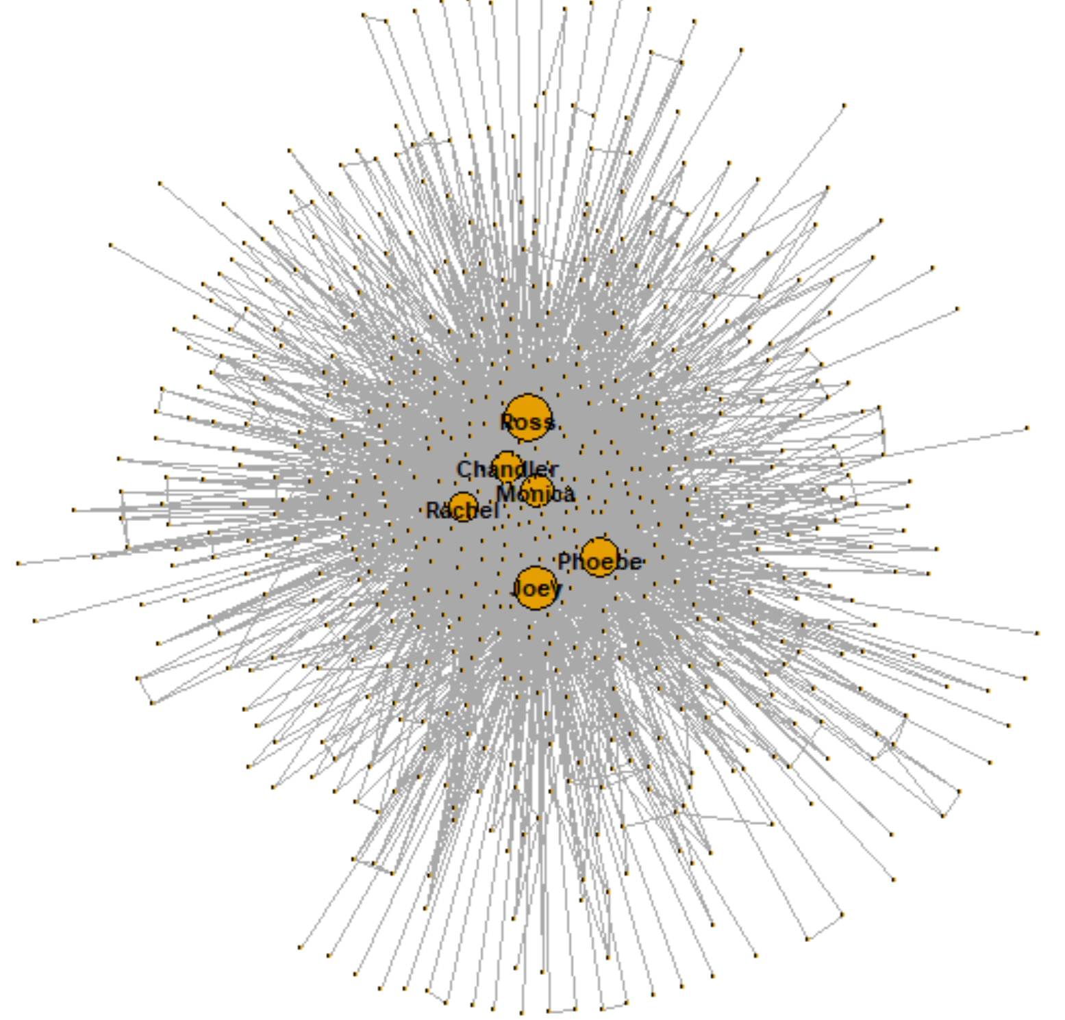
NETWORK CENTRALITY MEASURES
These centrality measures helps us in determining who are the active and influential rates among the network. The word influential is coincident with the definition of centrality.
Quantifies the number of times a node acts as a bridge along the shortest path between two other nodes.
Ross has maximum degree followed by Joey. This shows that Ross is one character that has very much influence on the flow of information in the network.
This measure provides measure of the influence or importance of a node.
Ross, Joey & Chandler have high values of degrees. Mean degree of Friends network is 4.555385.
How close a node to any other node in the network.
Ross, Joey & Phoebe have high closeness. This shows node “Ross” is most central to all nodes in the network
Betweenness
Centrality
Degree
Centrality
Closeness
Centrality

Slide 7


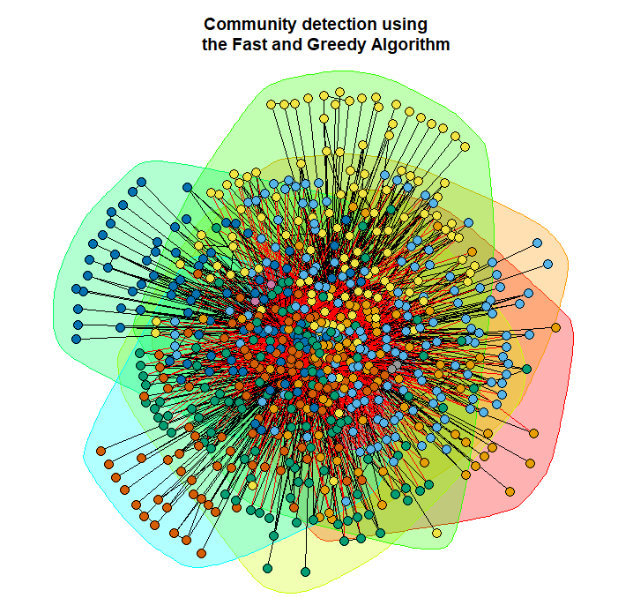
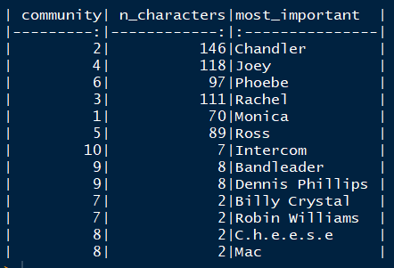
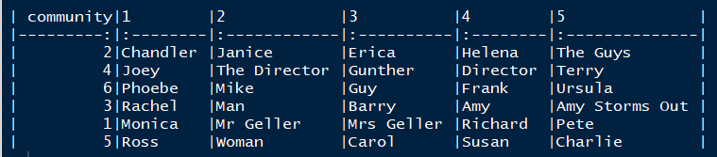
COMMUNITY DETECTION USING THE FAST AND GREEDY ALGORITHM

Slide 8
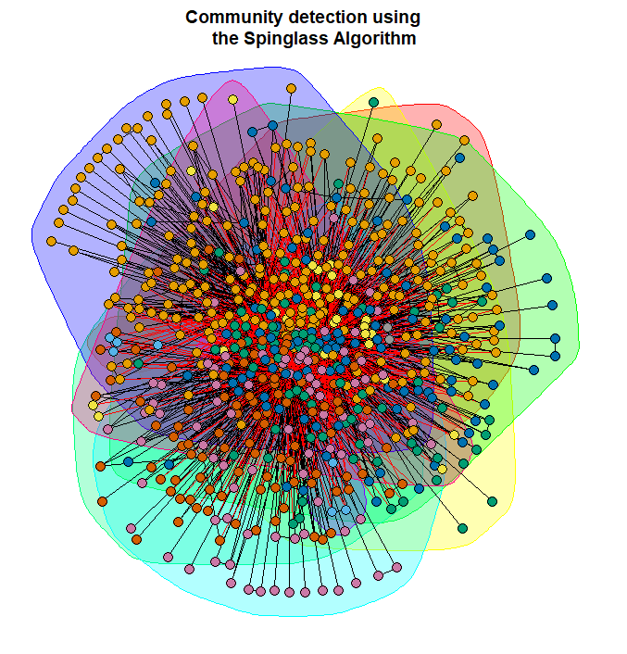
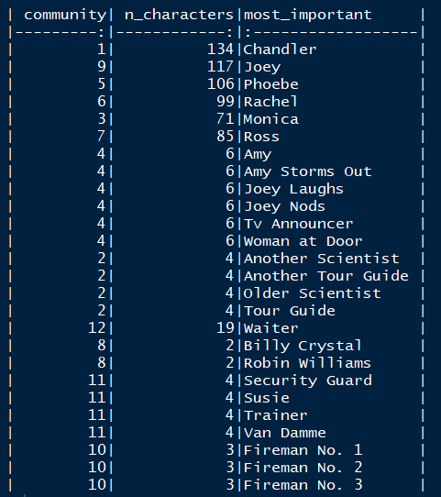
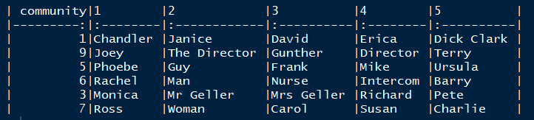
COMMUNITY DETECTION USING THE SPINGLASS ALGORITHM

Slide 9


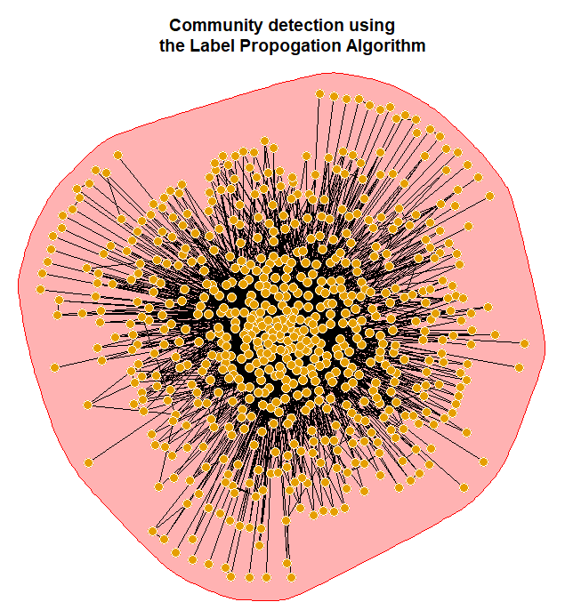
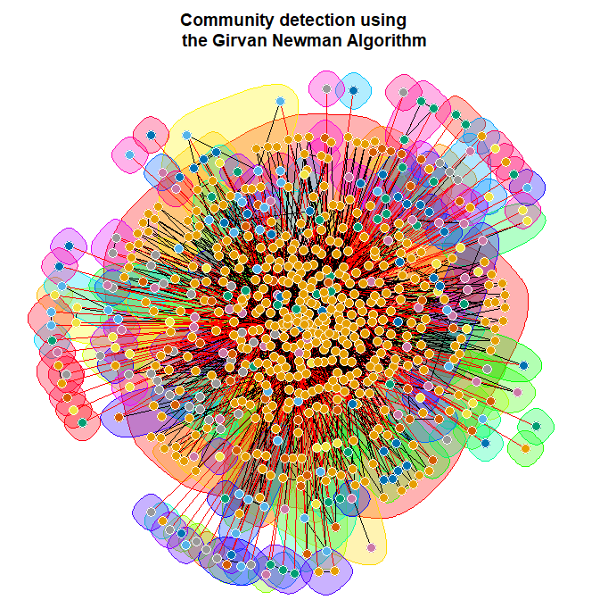
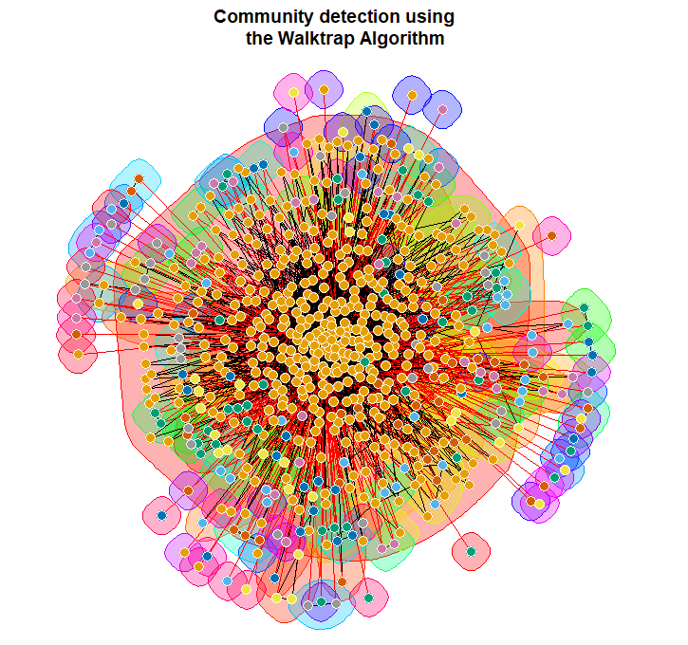
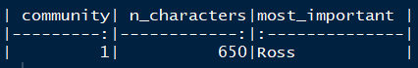
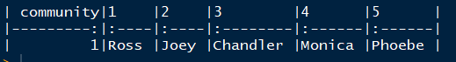
COMMUNITY DETECTION USING THE LABEL PROPAGATION ALGORITHM
COMMUNITY DETECTION USING THE GIRVAN NEWMAN ALGORITHM
COMMUNITY DETECTION USING THE WALKTRAP ALGORITHM

Slide 10


FUTURE SCOPE
If more information on the kind of interactions they had like whether it was a positive or negative conversation and the emotion details, then we would like to further do some – Sentimental analysis and Text analytics
Our analysis so far forms the foundation for community detection, but we would like to explore more complex community detection algorithms for better insights

Slide 11





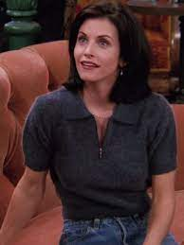

CONCLUSION
The results achieved from both our community detection algorithms are similar –
Chandler – Apart from the 5 friends and Janice, Chandler does not have a lot of connections.
Joey – Apart from Gunther, Joey is mostly connected to directors and agents.
Phoebe - Apart from her sister, phoebe is strongly connected to the men in her life.
Rachel – Rachel seems to be connected strongly to Barry and her daughter, Amy.
Monica – Her community includes her parents and boyfriends
Ross – Ross’s community is dominated by his ex-wife Carol and her girlfriend Susan as well as Charlie

Slide 12
THANK YOU

